Slide 1


A. Miskelis
09/02/23

Slide 2

Outline
Executive Summary
Introduction
Methodology
Results
Conclusion
Appendix

Slide 3
Executive Summary
Summary of methodologies
Summary of all results

Slide 4
Introduction
Project background and context
Problems you want to find answers

Slide 5

Section 1

Slide 6
Methodology
Executive Summary
Data collection methodology:
Describe how data was collected
Perform data wrangling
Describe how data was processed
Perform exploratory data analysis (EDA) using visualization and SQL
Perform interactive visual analytics using Folium and Plotly Dash
Perform predictive analysis using classification models
How to build, tune, evaluate classification models

Slide 7
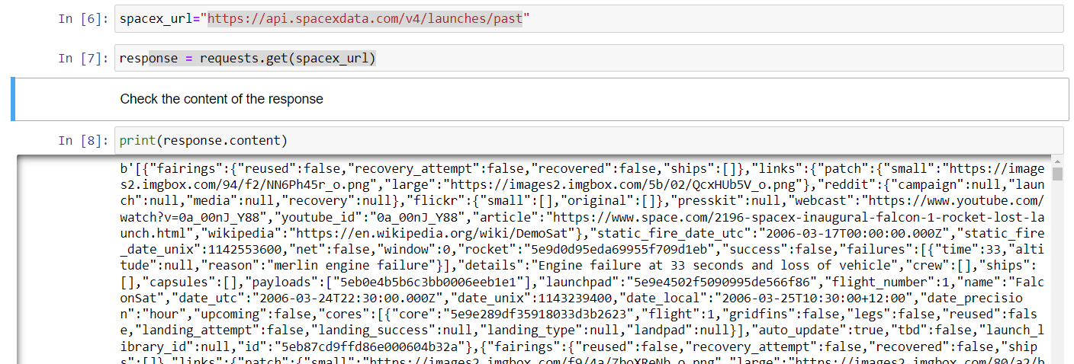
Data Collection
To collect data I have used SpaceX API with the following URL: https://api.spacexdata.com/v4/launches/past
To request data library requests was used

Slide 8
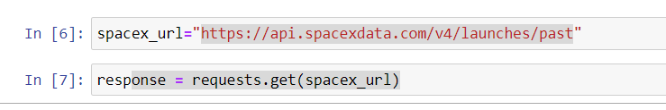
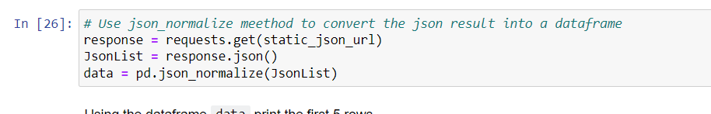
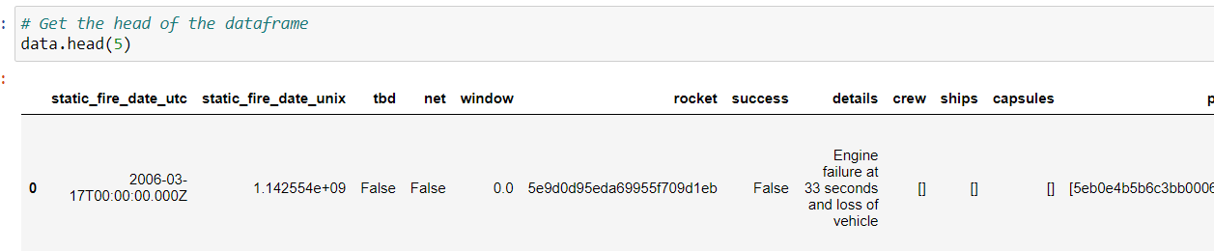
Data Collection – SpaceX API
Present your data collection with SpaceX REST calls using key phrases and flowcharts
https://github.com/armanius87/course/blob/main/1%20course/jupyter-labs-spacex-data-collection-api%20(4).ipynb

Slide 9
Data Collection - Scraping
Present your web scraping process using key phrases and flowcharts
Add the GitHub URL of the completed web scraping notebook, as an external reference and peer-review purpose
Place your flowchart of web scraping here

Slide 10
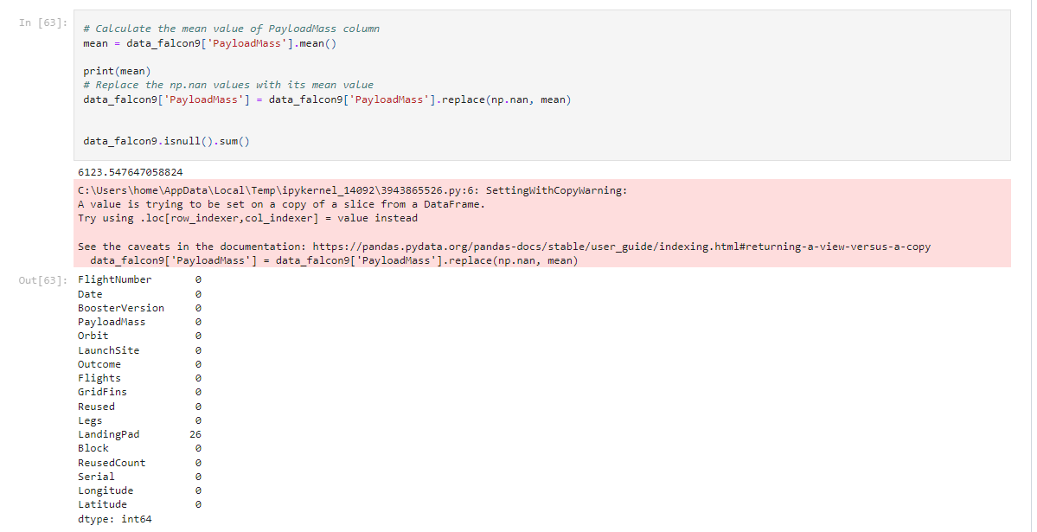
Data Wrangling
https://github.com/armanius87/course/blob/main/1%20course/jupyter-labs-spacex-data-collection-api%20(4).ipynb

Slide 11
EDA with Data Visualization
Relationship between Flight Number and Launch Site
Relationship between Payload and Launch Site
Relationship between success rate of each orbit type
Relationship between FlightNumber and Orbit type
Launch success yearly trend
https://github.com/armanius87/course/blob/main/1%20course/jupyter-labs-eda-dataviz.ipynb

Slide 12
EDA with SQL
Using bullet point format, summarize the SQL queries you performed
Add the GitHub URL of your completed EDA with SQL notebook, as an external reference and peer-review purpose

Slide 13
Build an Interactive Map with Folium
Markers
Circles
Marker_cluster
https://github.com/armanius87/course/blob/main/1%20course/lab_jupyter_launch_site_location.ipynb

Slide 14
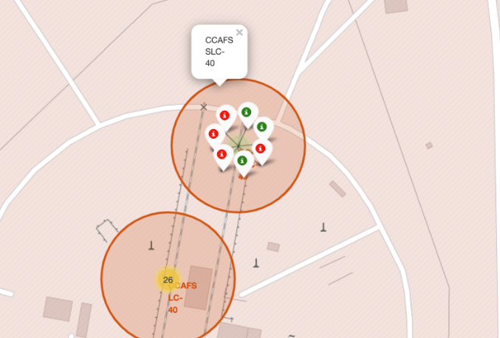
Build a Dashboard with Plotly Dash
https://github.com/armanius87/course/blob/main/1%20course/lab_jupyter_launch_site_location.ipynb

Slide 15
Predictive Analysis (Classification)
Logistic Regression
Support vector machine
Decision tree classifier
K nearest neighbors
https://github.com/armanius87/course/blob/main/1%20course/SpaceX_Machine%20Learning%20Prediction_Part_5%20(2).ipynb

Slide 16
Results
Exploratory data analysis results
Interactive analytics demo in screenshots
Predictive analysis results

Slide 17

Section 2

Slide 18
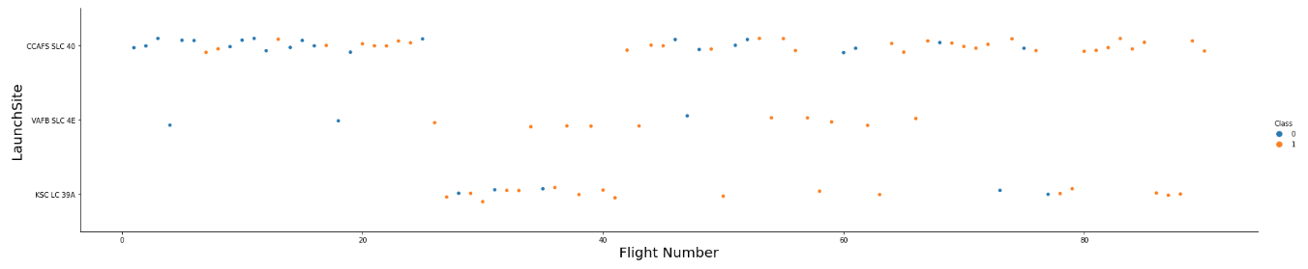
Flight Number vs. Launch Site

Slide 19
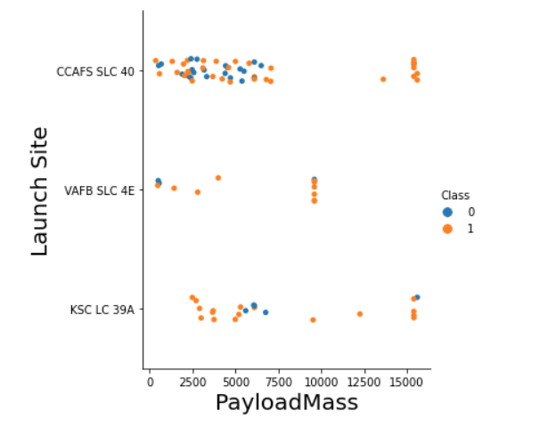
Payload vs. Launch Site

Slide 20
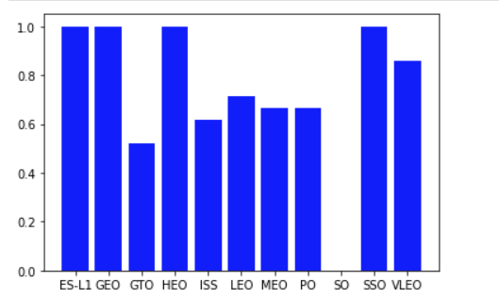
Success Rate vs. Orbit Type

Slide 21
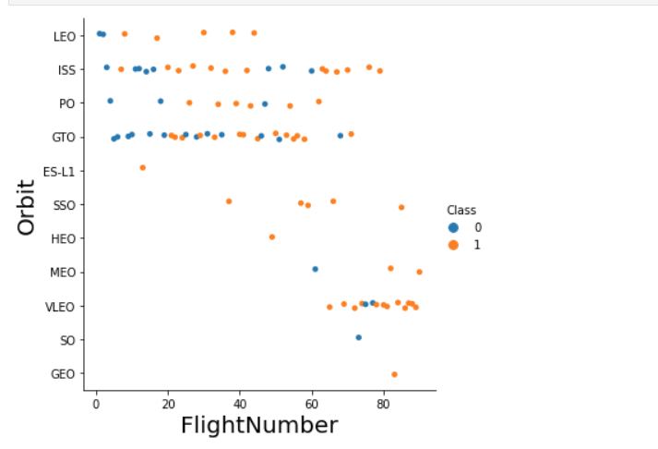
Flight Number vs. Orbit Type

Slide 22
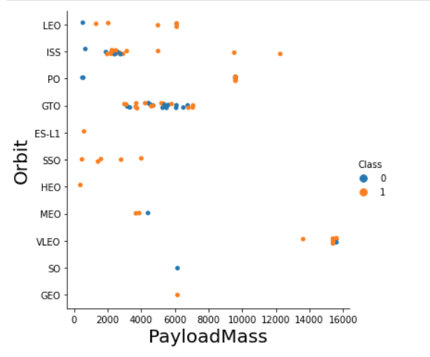
Payload vs. Orbit Type

Slide 23
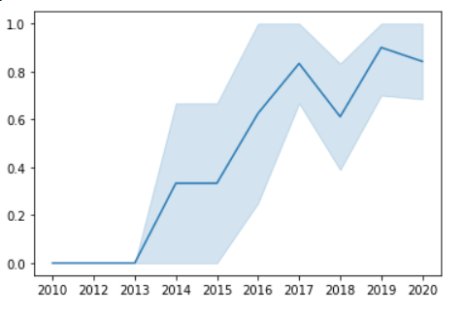
Launch Success Yearly Trend

Slide 24
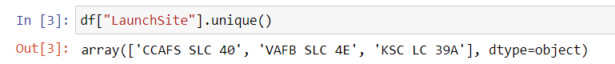
All Launch Site Names
Find the names of the unique launch sites
Present your query result with a short explanation here

Slide 25
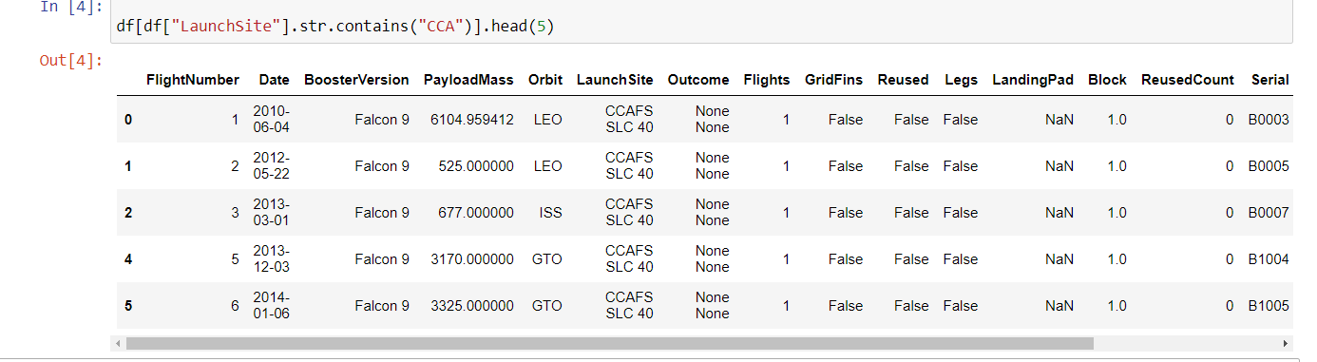
Launch Site Names Begin with 'CCA'
Find 5 records where launch sites begin with `CCA`
Present your query result with a short explanation here

Slide 26
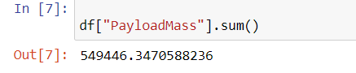
Total Payload Mass
Calculate the total payload carried by boosters from NASA
Present your query result with a short explanation here

Slide 27
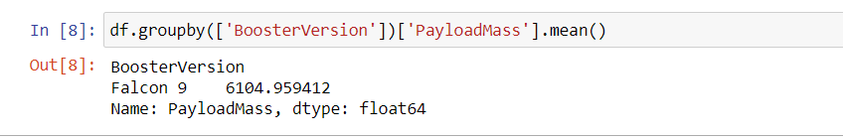
Average Payload Mass by F9 v1.1
Calculate the average payload mass carried by booster version F9 v1.1
Present your query result with a short explanation here

Slide 28
First Successful Ground Landing Date
Find the dates of the first successful landing outcome on ground pad
Present your query result with a short explanation here

Slide 29
Successful Drone Ship Landing with Payload between 4000 and 6000
List the names of boosters which have successfully landed on drone ship and had payload mass greater than 4000 but less than 6000
Present your query result with a short explanation here

Slide 30
Total Number of Successful and Failure Mission Outcomes
Calculate the total number of successful and failure mission outcomes
Present your query result with a short explanation here

Slide 31
Boosters Carried Maximum Payload
List the names of the booster which have carried the maximum payload mass
Present your query result with a short explanation here

Slide 32
2015 Launch Records
List the failed landing_outcomes in drone ship, their booster versions, and launch site names for in year 2015
Present your query result with a short explanation here

Slide 33
Rank Landing Outcomes Between 2010-06-04 and 2017-03-20
Rank the count of landing outcomes (such as Failure (drone ship) or Success (ground pad)) between the date 2010-06-04 and 2017-03-20, in descending order
Present your query result with a short explanation here

Slide 34

Section 3

Slide 35
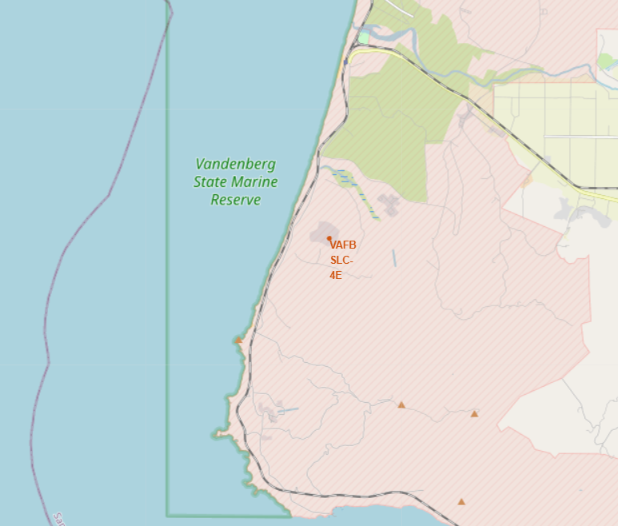
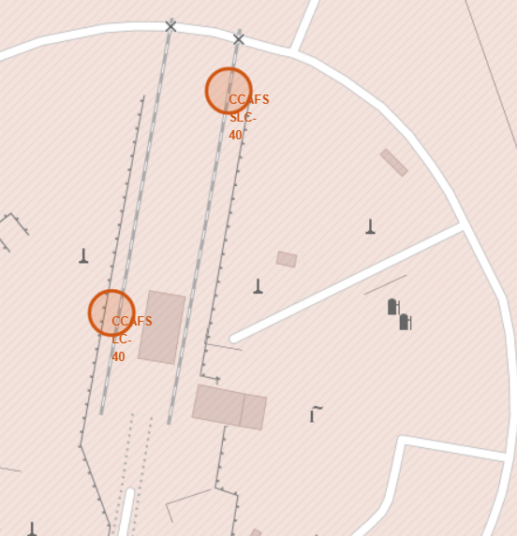
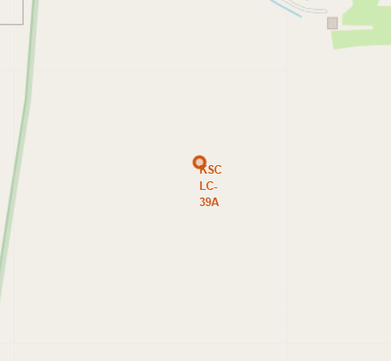
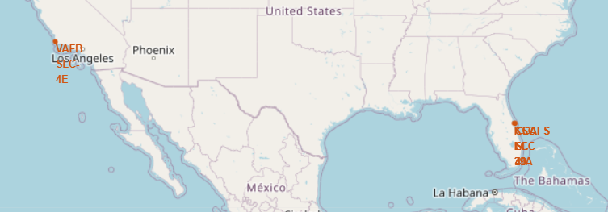
Launch Sites

Slide 36
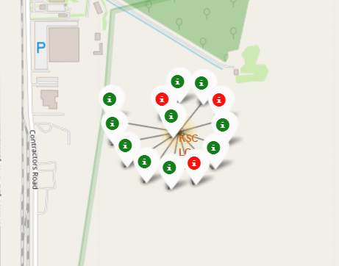
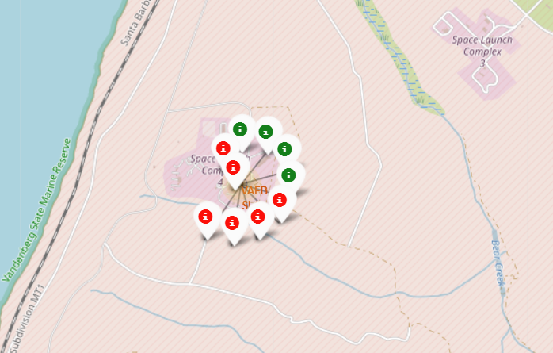
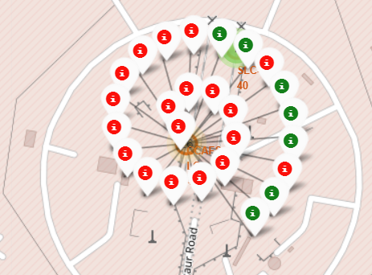
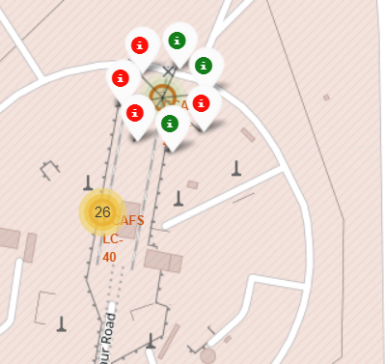
Launch outcomes

Slide 37
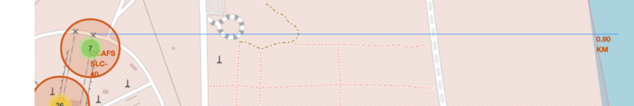
Line distance

Slide 38

Section 4

Slide 39
<Dashboard Screenshot 1>
Replace <Dashboard screenshot 1> title with an appropriate title
Show the screenshot of launch success count for all sites, in a piechart
Explain the important elements and findings on the screenshot

Slide 40
<Dashboard Screenshot 2>
Replace <Dashboard screenshot 2> title with an appropriate title
Show the screenshot of the piechart for the launch site with highest launch success ratio
Explain the important elements and findings on the screenshot

Slide 41
<Dashboard Screenshot 3>
Replace <Dashboard screenshot 3> title with an appropriate title
Show screenshots of Payload vs. Launch Outcome scatter plot for all sites, with different payload selected in the range slider
Explain the important elements and findings on the screenshot, such as which payload range or booster version have the largest success rate, etc.

Slide 42

Section 5

Slide 43
Classification Accuracy
Visualize the built model accuracy for all built classification models, in a bar chart
Find which model has the highest classification accuracy

Slide 44
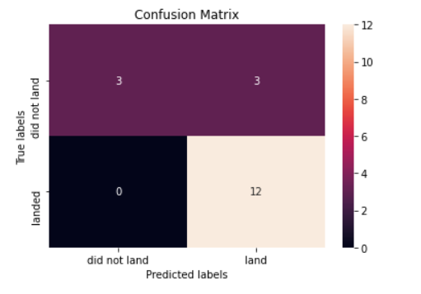
Confusion Matrix
Decision tree classifier

Slide 45
Conclusions
Decision tree has provided best accuracy
KsC39 LC39A has most successful launches
KsC39 LC39A shows great sucses at low load as well high loads.

Slide 46
Appendix
Include any relevant assets like Python code snippets, SQL queries, charts, Notebook outputs, or data sets that you may have created during this project

Slide 47


